Slide 1
Hitachi NAS Platform, powered by BlueArc®
Technical Presentation
NAS Product Management
October, 2010

Slide 2
Agenda
Hardware Overview
Software Overview

Slide 3
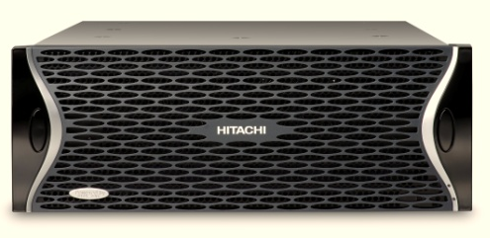
Model Comparison
Scaled performance and greater connectivity options …
 | Hitachi NAS 3080 | Hitachi NAS 3090 | HNAS 3100 (FSX) | HNAS 3200 (FSX)
File System Object | 16 Million per Directory | 16 Million per Directory | 16 Million per Directory | 16 Million per Directory
SpecSFS IOPs | 60,000 | 100,000 | 100,000 | 193,000
Throughput | Up to 700 MB/Sec * | Up to 1,100 MB/Sec * | Up to 850MB/sec | Up to 1600 MB/Sec
Scalability | 4 Petabyte(¹) | 8 Petabytes(²) | 8 Petabytes(²) | 16 Petabytes(³)
File System Size | 256 Terabytes | 256 Terabytes | 256 Terabytes | 256 Terabytes
Ethernet Ports | x 1 Gigabits and 2x 10Gb | 6 x 1 Gigabits and 2x 10Gb | 6 x 1 Gigabits or 2x 10Gb | 6 x 1 Gigabits or 2x 10Gb
Fire Channel Ports | 4x 4/2/1 Gigabits Ports | 4x 4/2/1 Gigabits Ports | 4x 4/2/1 Gigabits Ports | 8x 4/2/1 Gigabits Ports
# Nodes / Cluster | Up to 2 Nodes | Up to 4 Nodes(⁴) | Up to 8 Nodes | Up to 8 Nodes
Require storage LUN size greater than 4TB ⁽²⁾ Require storage LUN size greater than 8TB ⁽³⁾ Require storage LUN size greater than 16TB.
⁽⁴⁾ Available with later build release

Slide 4



Up to 4 Way Clustering Support (later release)
Features:
  Clusters Now Scale from 2, 3, 4 Nodes
  Read Caching Capability
  64 Enterprise Virtual Servers Per node or Cluster (optional Virtual Server Security for each EVS)
  Rolling Upgrades
  512 TB of Shared Storage 2TB LUN; supports up to 2PB capacity with LUN size greater than 8TB
  Supports Cluster Name Space
Benefits:
  Near linear scaling aggregate Performance
  Sharing a Large Centralized Storage Pool
  More Effective Distribution and Migration of Virtual Servers
  Excellent for HPC or Large Clusters Which Need Higher Random Access Performance to Several File System Data Sets
  Acceleration of NFS Read Workload Profiles
  Supports Redirection for CIFS Workload Profiles
2
4
- Way Clusters
Shared SAN
10 Gigabit Ethernet Links for
cluster interconnects +
Shared SAN Back-End

Slide 5
2-nodes up to 4-nodes cluster NVRAM mirroring
Node A
Node B
NVRAM :
2GB with 3080/3090
NVRAM
NVRAM
Node A
Node B
Node C
Node D
NVRAM
NVRAM
NVRAM
NVRAM
NVRAM gets flushed to disk randomly every 1 to 6 seconds
** 4 nodes will become available at later release

Slide 6
Architecture Comparison
Memory
Memory
Memory
Memory
CPU
Memory
Memory
Software
Overhead
FPGA
FPGA
Contention
North Bridge/
Front Side Bus
Bottleneck
Dual Pipeline Architecture
Memory
Memory
Memory
Contention
South Bridge/
I/O Bus
FPGA
FPGA
Memory
Memory
Memory
Memory
Memory
Memory
Architecture
PC Server Architecture
Highly parallel
Optimized for data movement
Similar to network switches or routers
Highly serial
Optimized for general purpose computing
Similar to a laptop or pc

Slide 7
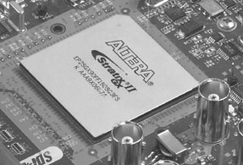
FPGA vs. CPU based Architectures
Parallelized vs. Serialized Processing
Parallelized Processing
Distributed processing for specific tasks
Multiple Tasks per clock cycle
Distributed memory
No shared buses
Serialized Processing
Shared processor
Shared memory
Single tasks per clock cycle
Shared buses

Slide 8

Technology
Hardware (FPGA) accelerated SW (VHDL) implementation of all key server elements
  Network access – TCP/IP
    Core TCP/IP done via HW accelerated SW
    Advanced congestion control algorithms
    High-performance TCP extensions (e.g., PAWS, SACK)
    Processor for management & error handling
    High performance and highly scalable TCP/IP offload functions
  File access protocols (NFS/CIFS)
    Implemented in VLSI (FPGA)
    Massively parallel separation of functions
      Dedicated processing and memory
      Data never leaves the data path
    Auto-response (response packets generated w/o CPU involvement)
    Auto-inquiry (request packets processed w/o CPU involvement)

Slide 9

Technology
File System
  Consistency and stable storage (checkpoints and NVRAM)
  Core FS implemented in VHDL executing on FPGAs
  Files and directories and Snapshots
  Metadata caching and Free space allocation
  Redundant O-node implementation working on one side of the O-node while there is always a consistent state on the secondary side to avoid lengthy fscks.
Disk Access ( Fibre Channel )
  Driven over PCI by FPGA instead of CPU
  Software device driver accelerated in HW
  All normal disk accesses generated by FPGA
  FPGA also implements large sector cache
  Processor for management & error handling

Slide 10
CIFS v2
CIFSv2 (also known as SMB2 or MS-SMB2) introduces the following enhancements:
  Ability to compound multiple actions into a single request
    Significantly reduces the number of round-trips the client needs to make to the server, improving performance as a result
  Larger buffer-sizes
    Can provide better performance with large file-transfers
  Notion of "durable file handles“
    Allow a connection to survive brief network-outages, such as may occur in a wireless network, without having to construct a new session
  Support for symbolic links
CIFS clients will auto-negotiate

Slide 11
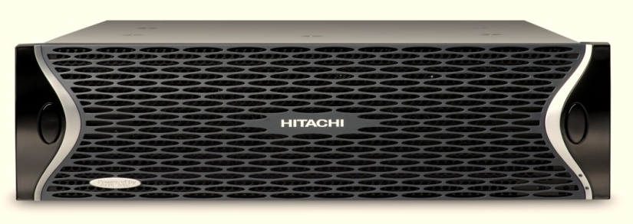
Hitachi NAS Platform
Performance & scalability Features
3090 single node
IOPS per server (SPECsfs profile)
Max NFS simultaneous connections
Max CIFS simultaneous connections
100,000
60,000
15,000 per node
Max. cluster addressable space
Volume size
2PB⁽¹⁾
256 TB
High Availability Features
Fault tolerant architecture with redundant components
NVRAM Mirroring
Journaling Filesystem with checkpoint mechanism
File system Snapshots
Active/Active or Active/Passive clustering
Asynchronous data replication over IP
Synchronous data replication using TrueCopy
Number of volumes per server
128
Max. number of files or subdirectories per directory
Max $ NFS/CIFS shares
16 million
10,000
Max. number of snapshots per filesystem
1,024
⁽¹⁾ Require storage LUN size greater than 16TB.

Slide 12
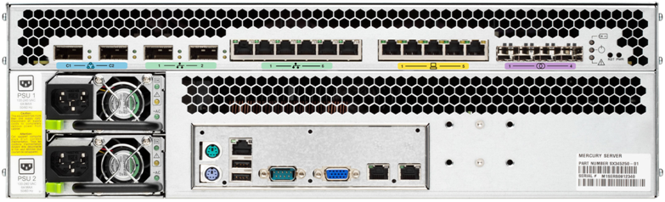
Hitachi NAS Port Connectivity
2 x 10GbE Cluster Interconnect
2 x 10GbE File Serving
6 x GbE
File Serving
5 x 10/100 Switch for
Management
4 x FC
Storage
Serial port located on front panel of chassis

Slide 13
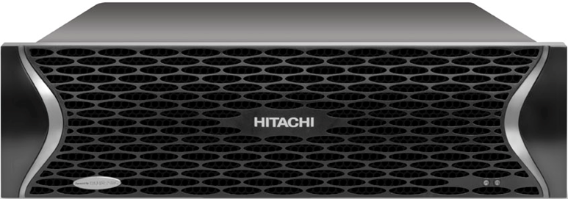
Bezel
Cooling Fans (not visible)

Slide 14
Agenda
Hardware Overview
Software Overview
Software bundles
Solutions Overview

Slide 15
Rolling cluster upgrades – what’s new
Allows upgrading nodes in a cluster one at a time
  No interruption of service for NFSv3 network clients
  CIFS and NFSv4 clients still need to re-logon by pressing F5
  Since 4.3.x code, HNAS support rolling upgrades for point builds only
    For example, 4.3.996d to 996j, or 5.1.1156.16 to 1156.17
Supports rolling upgrades to the next minor release
    For example, 6.0.<whatever> to 6.1.<whatever>
    But not 6.0 to 6.2 or 6.1 to 7.0

Slide 16
Multiple checkpoints
Checkpoints are used to preserve file changes (for FS rollback)
  The FS can preserves multiple CPs
    Default is 128, can be changed at format time (up to 2048)
  Changed blocks are released after oldest CP is deleted
Rolling back to a CP
  Any CP can be selected
  Rolling back to a CP does not affect existing snapshots taken prior to the CP that is being restored
  After a rollback to a CP, it is possible to roll back to an older CP
  After a rollback to a CP, it is possible to roll back to a more recent CP, but only if the file system has not been modified
    E.g., mount the FS in read only mode, check status, then decide if to re-mount the FS in normal (R/W) mode or rollback to a different CP
No license required for this feature

Slide 17
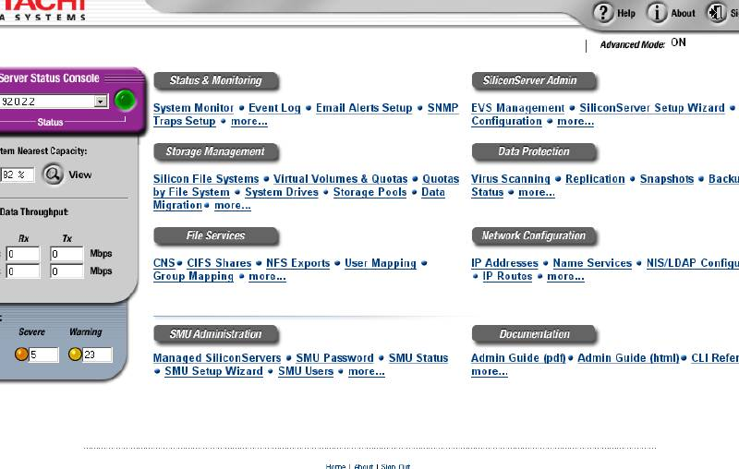
Software Suite
Virtualization
  Virtual File System
  Cluster Name Space
  Virtual Servers
  Virtual Volumes
Storage Management
  Integrated Tiered Storage
  Policy based data migration, classification and replication
Data Protection
  Snapshots
  Asynchronous and synchronous replication
  Disk-to-disk and disk-to-tape backup
  Anti-Virus Scanning
Integration with Hitachi Software
  Hitachi HiCommand® Integration with Device Manager and Tiered Storage Manager.
  Hitachi TrueCopy® Remote Replication and ShadowImage® In-System Replication software integration
  Hitachi Universal Replicator
  Hitachi Dynamic Provisioning on USP
  Hitachi Data Discovery Suite and Hitachi Content Archive Platform

Slide 18
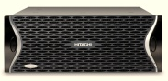
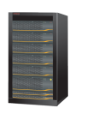
Virtualization Framework
Virtual File System unifies directory structure
and presents a single logical view
Virtual Servers allocate server resources for performance and high availability
Virtual Storage pools simplify storage provisioning for applications and workgroups
Virtual tiered storage optimizes performance, high availability and disk utilization across arrays
Virtual File System
Global Name Space with single root up to 4PB depending on the LUN size and storage model
Virtual Servers
NAS Cluster
Up to 64 Virtual Servers per System
Virtual Storage Pools
Storage Pool
Multiple File Systems Per Storage Pool
Storage Pool
File System
File System
File System
Virtual
Volumes
Multiple dynamic Virtual Volumes per File System
Virtual Tiered Storage
Parallel RAID Striping with hundreds of spindles per span

Slide 19








Virtual Storage Pools
Features:
  Thin Provisioning
  Individual or clustered systems
  Dynamically allocates storage to file systems and manages free space
  Virtualizes RAID sets
  Virtualizes file system storage
Benefits:
  Increases overall storage utilization
  Simplifies management
  Manages unplanned capacity demand
  Lowers cost of ownership
File System1
File System2
File System3
Un-allocated Free Space
Logical Storage Pool
RAID Sets

Slide 20
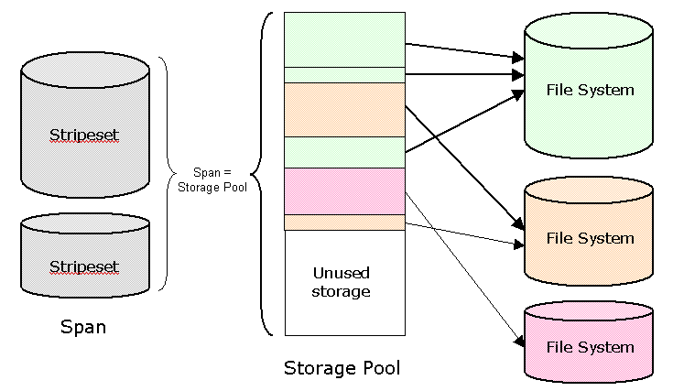

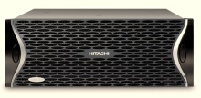
Virtual Storage Pools
Storage provisioning for clusters
Small volumes distributed across the span and stripesets
Storage allocation algorithm ensures optimal utilization of available storage
File Systems can grow automatically as needed
Cluster Name Space (CNS) combines multiple volumes into a single uniform File System
Allows manual load balancing across multiple cluster nodes (no data needs to be copied!)
Unified FS View (CNS)
Heavy Load
CNS
EVS/FS Load Balance

Slide 21

Thin Provisioning
Features:
  Provisions storage as needed
  Spans across NFS and CIFS and acts transparent to the clients
  Threshold management
  Support up to 1PB behind one share⁽¹⁾
  Autogrow feature based on Thresholds
Benefits:
  Thin Provisioning made easy
    Easy to manage (set once)
    Low Maintenance (Autogrow triggered on pre-defined thresholds)
Company
Geography
Department
CIFS and NFS Clients
5TB Share/Export
20TB Share/Export
Shrinking share online
Cluster
Name Space
1TB
File
System
Example process:
  Create 20TB Share/Export to clients
  Set threshold for File systems e.g. 75%
  Set Autogrow size e.g. 1TB
  Enable Autogrow
2TB
File
System
2TB
File
System
File System
One
File System
Two
75% threshold
⁽¹⁾ Require storage LUN size greater than 4TB.
With the new AMS2100 and 2300, you could have a max of capacity of 4PB.

Slide 22
Cluster Name Space
Features:
  Cluster name space
  Spans across NFS and CIFS so multiple volumes act as a single name space
  Dual 10 GigE Cluster Interconnect
  Request Redirection in hardware
  Multi-node Read Caching
Benefits:
  Single mount point and file system for simplified user administration
    Universal Access
    Unified Directory Structure
  Load balancing
    Front-end load balancing for clients
    Back-end load balancing utilizing high speed cluster interconnect
Company
Geography
Department
CIFS and NFS Clients
/department
Cluster of 4 nodes
/sales
/R&D
/support
/finance
/marketing
/operations
/HR
/testing

Slide 23
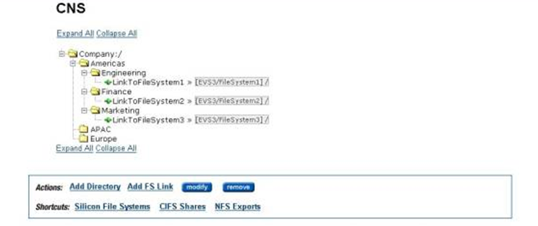
Cluster Name Space Example
Virtual links to
file systems
Single root with
unified corporate
directory structure
File systems assigned
to Virtual Servers
Logical company,
geography, and
department
directories

Slide 24
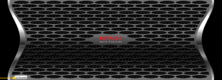
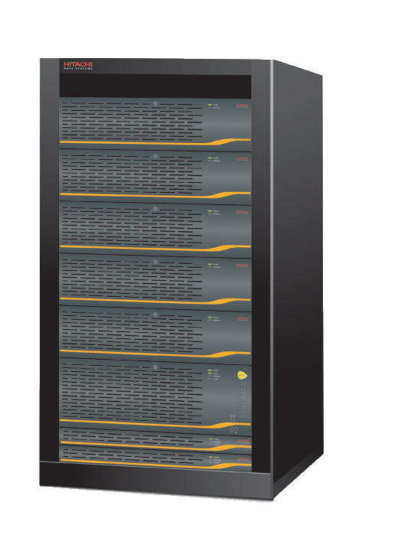

Virtual Servers
Allows administrators to create up to 64 logical servers within a single physical system. Each virtual server can have a separate address and policy and independent security settings.
Features:
  64 virtual servers per entity (single, dual, 3 or 4 nodes cluster is one entity)
  Separate IP addresses and policies
  Migration of virtual servers with their policies between local or remote NAS nodes
  Clustering support with failover and recovery
  Optional license for enhanced security by independent EVS settings
Benefits:
  Reduces downtime
  Simplifies management
  Lowers cost of ownership
EVS
1
EVS
3
. . . .
EVS
2
IP Address
Policy
IP Address
Policy
IP Address
Policy

Slide 25
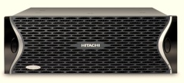
Read Caching
(see Read Caching section for details)
Features:
  Designed for Demanding NFSv2/NFSv3 Based Protocol Workloads
  Designed Read Traffic Profiles
  Read Caching Accelerates NFSv2/NFSv3 Read Performance up to 7 times
Benefits
  Ideal for Unix Environments
  Significant Increase in the Number of Servers and Clients Supported
Read
Caching
Primary
Image
Copy2
Copy3
Copy4
Shared SAN
SAN
Multiple Local Copies
Synchronized Read Images

Slide 26
Dynamic Write Balancing (DWB)
(see DWB section for details)
A solution to the “re-striping problem”
  Encountered by some customers as they expand a storage pool
    Performance does not increase linearly as storage is added
    And, in fact, it may decrease (e.g. adding stripeset that is of different Geometry)
DWB distributes writes “intelligently” across all available LUNs
  Performance will be more “balanced”
  Performance will increase as you add storage
    HNAS will take advantage of new storage immediately
DWB is only supported on HNAS 3x00 generation

Slide 27
Dynamic Read Balancing (DRB)
DRB (along with DWB) solves the “re-striping problem”
  Challenges encountered by customers as they expand storage pool
    Performance does not increase linearly as storage is added
    In fact, it may decrease (e.g. added stripeset is a lot smaller)
  Used against us as a “competitive advantage” by 3Par and Isilon
DRB is a “complementary feature” to DWB
  Utility that re-distributes existing files across multiple stripesets
  Once completed, reads will be distributed across all available LUNs
  DRB does requires DWB and thus only works on the 3000 generations (or later h/w)

Slide 28
Storage handling Enhancements
Features:
  Data Relocation (Transfer Between Sub-Systems)
  Storage SAN Automated Multi-Path Load Re-distribution and Optimization
Benefits:
  Better asset management over time, transition old to new
  The number of hard drives can be increased to expand performance levels
  Optimization of I/O workload distribution for the storage connectivity

Slide 29
Data and FS Relocation Solutions
Designed to support the following requirements:
  Relocating data as well as configuration settings (e.g. CIFS shares, CNS links, etc.) from one file system to another.
  Relocating or transferring data from any storage subsystem to a new storage subsystem
  Breaking up a single large file system into multiple, smaller file systems in a storage pool
  Moving an EVS and all its file systems to another NAS node unit that does not share the same storage devices (or if the structure of the data needs to be changed)
  Rebalancing file system load by moving data from one file system to another
The majority of the transfers are done online, the actual take or give over was designed to minimize customer downtime and any reconfiguration changes.

Slide 30
Multi-stream replication
Uses multiple concurrent streams to transfer the data
  Different connections are used to copy different subdirectories (read-ahead)
  Overcomes the large delays inherent in metadata intensive I/O operations
Parallelism
  Better use of HNAS capabilities
    Metadata (and data) access occurs in parallel
    Alleviates some of the latency problems seen in the past
    Overcomes bandwidth limitations for individual connections
Widely spaced access
  Data accessed in different parts of the file system
    Should cause concurrent access across multiple LUNs
    Avoids some of the locking problems seen in previous releases
  However, may could cause more disk head movement
Parameter
  Configurable (default = 4 substreams + 8 readahead processes)
  Max is 15 substreams per replication (30 readahead processes)
    Server-wide max is 64 substreams, 80 RA procs, 100 async reads

Slide 31

Network and Protocol Enhancements
ICMP Protocol Support
  Internet Control Message Passing Protocol
  Provides automated gateway and router discovery
RIPv2 Protocol Support
  Routing Information Protocol Version 2
  Helps HNAS to dynamically and automatically adapt to changes in routing paths through the network.
Global Symbolic Link Support
Client Link Aggregation Support (next slide)

Slide 32

Client Link Aggregation Support
Features:
Use of parallel GbE links to increase throughput beyond the speed of a single link, port, or cable (teaming, bonding, trunking, aggregation group)
Designed for clients that have implemented Link Aggregation (Trunking/LAG/802.3ad) to better match their performance capability.
Hitachi NAS Platform already supported LAG to switches, this enhancement extends it to support LAG from clients on the other side of the network for end-to-end LAG
Support VLAN and VLAN tagging.
Uses round robin distribution to optimize throughput
Benefits:
Anywhere from 2 to 6 Ethernet connections can be aggregated into a single trunk with shared distributed workload across all links for performance.
Significant performance improvements for specialized high performance client requirements like data bases, messaging applications and High Definition Video Processing.
Includes NFS, CIFS and iSCSI Support
Primarily design for servicing client systems with a dedicated high performance workload requirement
Client Link
Aggregation
iSCSI Connections
Database Applications
HD Video Processing
Client/Application Clusters

Slide 33


Policy Based Data Management with NAS Data Migrator
Enables administrators to automatically migrate data from a file system or virtual volume using data management policies based on a set of rules, parameters, and triggers.
Features:
Rules based policy engine
  Rich set of migration rules
  Capacity based thresholds
  Automated scheduler (one time or recurring)
  “What if” analysis tools and reporting
Leverages MTS for
  Optimal performance
  Minimal impact on network
Benefits:
Transparent to end users
Simplifies management
Lowers cost of ownership
  Does not require additional server
  Improves storage efficiency
Policies
Automatic Data Migration
If not used recently
Then move
Else….
File based
Fast Disk
$$$$
Slow Disk
$$

Slide 34



Combining NAS and SAN Virtualization
Content Awareness
_{MP3}
_{PPT}
_{DOC}
_{XLS}
_{MDB}
_{MOV}
_{PST}
Client files
Hierarchical Storage Management
  Moves files to new location and leave stub behind pointing to the new location
Tiered storage
  External/Internal storage support for multi-tiered storage
Central Policy based Engine
  File type (PPT, MP3, JPG etc.)
  File size
  Last access time
  File location
  Capacity threshold
Data classification
….
HNAS cluster
Management
Station
FS1
FS2
_{MP3}
USP
With internal
disks
_{DOC}
_{XLS}
Virtualized
storage
THUNDER
9585V
IBM
DS4000
SERIES
WMS100
EMC
CLARiiON
Example policies:
Move all files bigger than 10MB to SATA
Move all files older than 90 days to FC Tier 2
Move all XLS to Tier 1
FS4
FC
FS3
SATA
Tiered storage LUN migration after classification using Tiered Storage Manager from the USP/NSC
Whitepaper on Tiered Storage: Click here

Slide 35
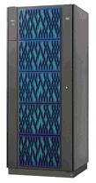
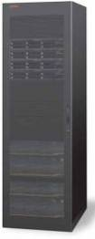
NAS Data Migrator CVL vs XVL
(see XVL section for details)
_{MP3}
_{PPT}
_{DOC}
_{XLS}
_{MDB}
_{MOV}
_{PST}
Client files
Example policies:
….
HNAS cluster
2 to 8 nodes
Regardless of file type if bigger than 20MB move to Tier-2
FC
NFSv3
If file 6 months old move to HCAP
USP-V
HCAP
Advantages:
CVL: Allows tiering between on FC attached file systems e.g. FC to SATA on same array or between multiple arrays
XVL: Allows tiering between internal disks and external NFSv3 mounted file systems. In the case of HCAP a single file system of 80PB which is single file instanced and compressed can be the target.
FS1
FS3
FC
256TB
Stub (1Kb)
Stub (bs of FS + metadata)
SATA
256TB
FS2
80PB
Cross-Volume-Links
CVL
External-Volume-Links
XVL

Slide 36




iSCSI Overview
Enables block level data transfer over IP networks using standard SCSI commands.
Features:
NAS and iSCSI in a single system
Wire speed performance
Maximum 8,192 LUNs per node
Concurrent shared access to data
Virtualization, data protection, management features
Simplified setup with ISNS support
Enhanced security with authentication between initiator and target
Microsoft WHQL qualified
Multi-pathing support
iSCSI boot
Benefits:
Improved performance and scalability
Simplified management
Lower cost of ownership
Software or Hardware Initiator
Software or Hardware Initiator
Server
Server
SCSI Commands
iSCSI
Target
IP Network
Virtual
Server (EVS)
Logical Unit Number (LUN)

Slide 37
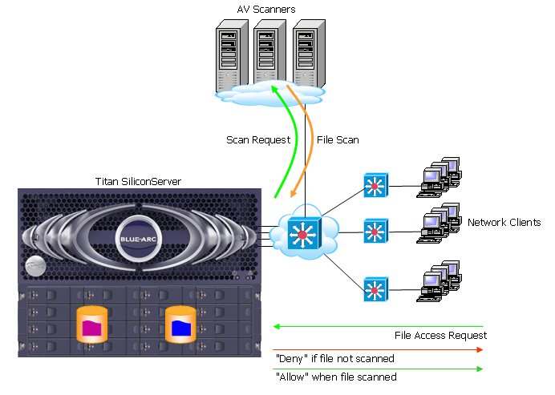
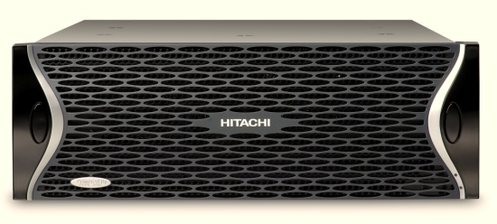
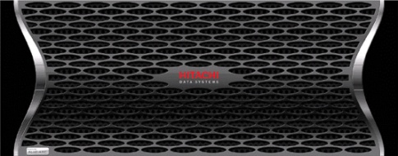
Data Protection Anti-Virus Support
AV Scanners
Files scanned on read (open) and on file close
Scanning configurable on a per share basis
NAS node interfaces to external virus scanners who scan files for viruses on read
  External scanners not provided by Hitachi Data Systems
Management and Configuration:
  Inclusion and exclusion lists supported
  File scanned statistics provided
  Standard configuration on AV scanners
Scan
request
File
Scan
File Access Request
“deny” if file is not scanned
“allow” when file scanned

Slide 38

Data Protection Anti-Virus Support—details
File’s AV metadata:
  Virus definitions version number
    Reset to “0” for every time a file is written to
  Volume Virus scan ID
    Also stored in Volume dynamic superblocks
File checks:
  If virus scanning is disabled, then grant access to the file.
  If the file has already been virus scanned, then grant access.
  If the client is a virus scan server, then grant access.
  If the file is currently being scanned, then wait for the result of that scan instead of sending a new one.
  If the file isn't in the list of file types to scan, then grant access.
  If there aren't any scan servers available to scan the file, then deny access.
  Send a request to a scan server to scan the file.
  If the file is clean or was repaired, then grant access.
  If the file is infected or was deleted/quarantined, then deny access.
AV servers:
  Named Pipes over CIFS used for bi-directional communication
  Round-robin load balancing when sending AV scan requests
  Should not have any user-level “CIFS” access to NAS node

Slide 39


Snapshots Overview
Allows administrators to create a cumulative history of data without duplication. Once the initial reference point is set then snapshots efficiently copy just the changes or differences that occurred between selected intervals.
Features:
Stores block level changes to data
  Hardware implementation for low overhead
Policy based snapshot management
  Automated scheduler (one time or recurring)
Up 1,024 snapshots per file system
Frequency can go down to 1 snapshot per second
File system, directory and file permissions are maintained
File system can be backed up from snapshots automatically
Benefits:
Increased data copy infrastructure performance
Improved data protection
Simplified management
Lower cost of ownership
Cumulative History
Delta View
Delta View
Delta View
Live File System

Slide 40

Snapshots Implementation
Pre-snapshot filesystem view @ t₀: Blocks A, B, C
Snapshot creation is instant, no data is copied t₁
When a write occurs to the file system at t₂, a copy of the Root Onode is created for the Snapshot. This Snapshot Onode points to the preserved data blocks
The incoming data blocks B’ & C’ are written to new available blocks. The new block (B’ & C’) pointers are added to the live Root Onode and the old pointers are removed (B & C)
The live Root Onode is used when reading the live volume, linking to live blocks (A, B’, C’)
The snapshot Onode is used when reading the snapshot volume, linking to the preserved blocks (B & C) and shared blocks (A)
Not all blocks are freed up upon snapshot deletion
Snapshots done in hardware - with no performance loss on reads or writes
Aggressive object read-aheads ensures high performance reads
Snapshots are done within the file system and not with copy-on-write differential volumes
Instant Snapshot Creation t₁
2
Snapshot Read
Live Read
Write t₂
6
5
Snapshot
Onode
3
Root
Onode
1
4
B’
C’
t₂
B
C
A
B
C
t₀

Slide 41
Restore file system from a snapshot (FSRS)
This is a licensed feature
Near-instant rollback of entire FS to a snapshot
  Different from the “File rollback” function requiring to copy preserved data for each file (slower)
  Made possible by the fact that WFS-2 preserves bitmaps with each snapshot
    WFS-2 can restore directly from the snapshot
    This works even if the live FS is not consistent
  The time required depends on the size of the file system
    Not on the number of files in a file system
  The ability to run chkfs on a snapshot makes it possible to validate the snapshot before it is restored
© 2009 BlueArc, Corp. Proprietary and Confidential.

Slide 42



Management Console
At-glance dashboard
Status alerts and monitoring
File and cluster services
Data management and protection
Anti-virus scanning
Network and security administration
Policy manager and scheduler
CLI and scripting
SSH, SSL, and ACL protection
On-line documentation library
Management Station

Slide 43
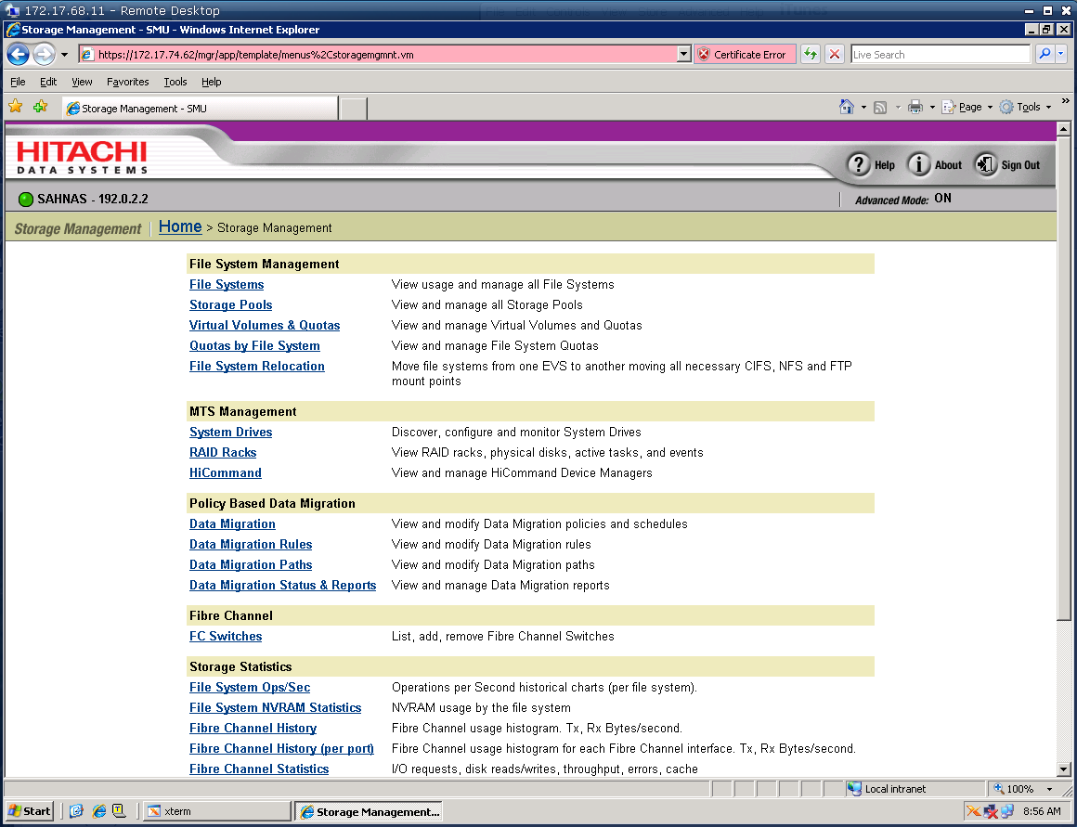
Hitachi HiCommand® Integration with Device Manager

Slide 44

Reporting and Management access
Hitachi HiTrack® integrated
SNMP v1/v2c
Syslog
Microsoft Windows Popups
Telnet/SSH/SSC access to NAS node CLI

